Slide 1

STOCK PITCH
Eleonore Chamboredon
Notes:
Add US ecommmerce as % of addressable retail.

Slide 2
Table of Contents
Investment Thesis
Company Analysis
Industry Overview
Valuation

Slide 3
I. INVESTMENT THESIS

Slide 4
Amazon is an American multinational tech company focusing on e-commerce and cloud computing, developing online advertising, digital streaming, and AI.
One of the Big Five American tech companies among Alphabet, Apple, Meta and Microsoft.
Growth prospects with development of AWS and the use of AI, well established retail business: compelling investment undervalued by the market.
Recommendation: Buy Current price: $187.57 Price Target: $307.75
64.1% Upside
CATALYSTS
Cloud computing:
Advancement of AI increases demand for cloud computing and AWS, accelerating Amazon’s growth prospect.
Amazon accelerates AWS investments to handle large-scale data and extend international supply.
Advertising: fastest growing segment with ad-tech, best margins in the tech industry.
Prime Video SVOD ads launched in January expected to generate between 3 to 3.3 billion revenue for Amazon.
Ads and AWS: fastest growing segments worth $1.26 trillion and drive gross margin and operating margin at records high.
E-commerce:
sales rose ~13% in 2024.
operating income grew more than 3x YOY.
Improved fast delivery services and the use of robots increasing warehouse activity speed.
Amazon will soon operate their own aircraft to reduce dependence on third party delivery services.
RISKS
Disruptions to logistic from global pandemic could affect the company’s primary e-commerce industry.
Amazon’s fast same/two-day delivery policy increases pressure on logistics operations to meet customers’ expectations, require heavy investment in logistic technology, inventory and labour.
AI and the tech industry are highly competitive environment.
Notes:
Considered one of the Big Five American tech companies (other 4th: Alphabet, Apple, Meta and Microsoft)

Slide 5
II. COMPANY ANALYSIS

Slide 6
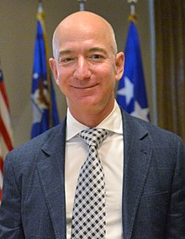
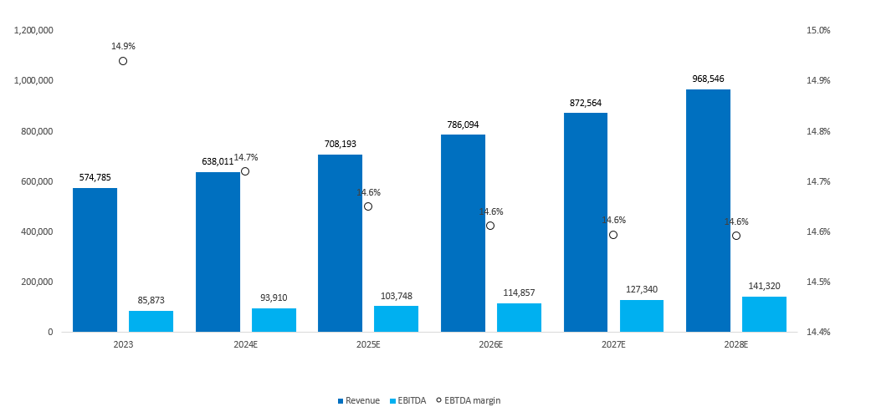
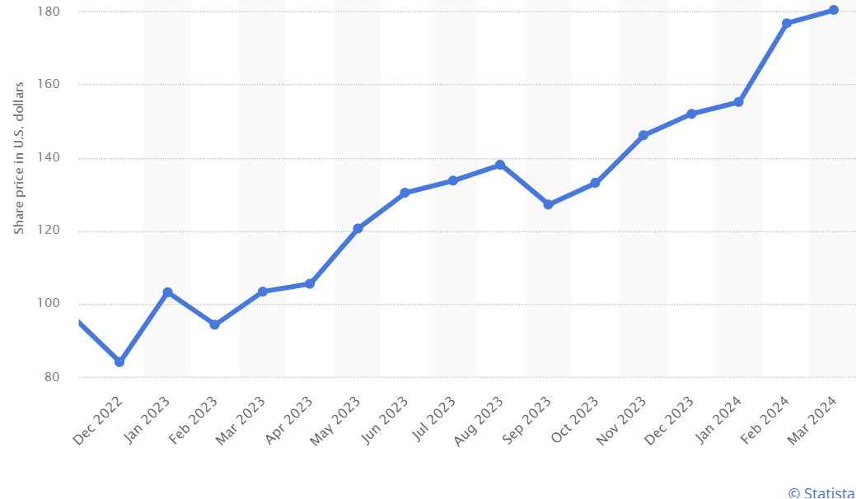
Ticker: (NASDAQ: AMZN)
MANAGEMENT
Launched in 1995 as a bookselling platform by Bezos in Washington, US.
1st strategy: “Get Big Fast” with the objective to become a tech company.
IPO in 1997, 1st recorded profit in 2003.
2000: 3rd party services to extend product offering.
2002: AWS, cloud computing suite featuring more than 200 services.
2023: 1/3rd of the cloud market, ahead of Microsoft and Alphabet.
Accounting for 15% to 18% of total sales, yielding 50% of EBIT.
2005: Amazon Prime, company’s bundle-of-services program with 200 million Prime members in 2023 across 19 countries. (Fast, free delivery)
2007: launched the online grocery store Amazon Fresh.
2017: Acquired Whole Foods for $13.7 billion (organic grocery store).
2023: Amazon Bedrock’s $4b investment in GenAI through Anthropic.
Founder, and chairman (1995 – present), CEO (-2021): Jeff Bezos
Worked in IB at Bankers Trust and D.E. Shaw &Co.
Founded Amazon in 1995.
2000: he founded Blue Origin (spaceflight company).
2007: he releases the Kindle, which becomes extremely popular.
2013: he bought The Washington Post for $250m.
2018 Bezos’s net worth was $112m - the richest person in the world.
President and CEO: Andy Jassy from 2021.
1997: joined Amazon as a marketing manager.
2006: co-founder with Bezos of the cloud computing platform (AWS)
2006 – 2021: SVP and CEO of AWS.
SHARE PRICE PERFORMANCE
FINANCIALS

Slide 7
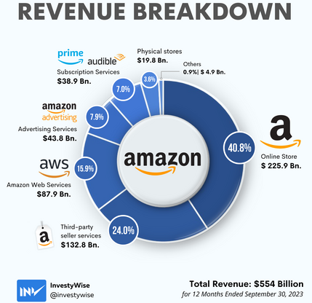
Products
For consumers, sellers, brands, developers, enterprises, and creators.
Amazon Store: 1.7 m small/medium businesses selling on Amazon.com.
Supporting sellers and serving customers (Amazon.com, Prime, music, Go, Fresh, Whole Foods Market).
Devices and services: Alexa, Echo, FireTablet, Kindle, FireTV, Ring, Blink.
Alexa’s voice control powers +140,000 smart home products.
Ambient intelligence using AI to improve customer experience.
AWS: World’s most comprehensive broadly adopted cloud, offering +200 fully featured services from data centres globally.
Compute, storage, database, analytics, mobile, developer & management tools, IoT, security, and enterprise applications.
For fast growing startups, large enterprises, leading government agencies,
Lower costs, increase security, become more agile, innovate faster.
Delivery and Logistics: Amazon fulfilment, Air, Last mile delivery, Customer service, Prime Air, Fulfilment Tech&Robotics.
Entertainment: Amazon Freevee, Games, Music, Studios, Audible, Prime Gaming, Prime Video, Twitch.
Global brand revenue 2023: $590.74B
YOY rev growth as of Q1 2024 (from Q4 2022):
Online store:7%, Physical store:6%, 3rd party seller services:16%, Advertising services:24%, Subscription services:11%, AWS:17%
Notes:
Amazon obsesses over how to make customers’ lives better and easier with new and improved products and services for consumers, sellers, brands, developers, enterprises, and creators.
Amazon Store: 1.7 million small and medium businesses worldwide selling on Amazon.com.
Supporting sellers and serving customers (Amazon.com, Prime, music, Go, Fresh, Whole Foods Market).
Devices and services: Alexa, Echo, FireTablet, Kindle, FireTV, Ring, Blink, Eero, Luna.
Alexa’s voice control powers +140,000 smart home products, +100 Alexa built-in and +130,000 other companies’ products.
Ambient intelligence using AI to improve customer experience.
AWS: World’s most comprehensive broadly adopted cloud, offering +200 fully featured services from data centres globally.
Compute, storage, database, analytics, mobile, developer tools, management tools, IoT, security, and enterprise applications.
Millions of customers: fastest growing startups, largest enterprises, leading government agencies,
Lower costs, increase security, become more agile, innovate faster.
Delivery and Logistics: Amazon fulfilment, Air, Last mile delivery, Customer service, Prime Air, Fulfilment Tech &Robotics.
Entertainment: Amazon Freevee, Games, Music, Studios, Audible, Prime Gaming, Prime Video, Twitch.

Slide 8
Strategy
Fundamental measure of success: long-term shareholders’ value creation, direct result of the ability to extend and solidify current market leadership position.
Leading to a more powerful economic model, translating into higher revenue, profitability, capital velocity, and ROI.
Obsess over customers: focus on offering them compelling value.
Driving selection:
US: Clinique and two Gen Z favourites, Parade and Cider
Europe: Collaboration with Hardly Ever Worn offer customers pre-owned items from luxury brands
New Gen AI tool that help 3rd party sellers to add products to Amazon stores: creates product detail pages on amazon using the seller’s URL.
+100,000 of amazon selling partners used 1/+ of amazon gen AI tools.
Focus on everyday low prices:
helped customers save with shopping events: Big Spring Sale (Canada, U.S), Spring Deal Days (EU), Ramadan event (Egypt, Saudi Arabia, and the UAE).
Faster delivery times:
In March, in the 60 largest U.S. metro areas, ~60% Prime members’ orders arrived same/next day. Toronto, London, and Tokyo, ~3/4 items same/next day.
Advertising:
Starting Prime Video ads to offer brands value better linking the impact of streaming TV advertising to business outcomes.
AWS:
Leveraging gen AI to change customer experiences and businesses. Amazon accumulated a multi-billion dollar revenue run rate.
Continue to add capabilities to the 3 types gen AI developers:
Developers building their own models: broad selection of NVIDIA instances but high demand for Amazon Trainium and Inferentia (favorable price)
Larger quantities of latest generation, Trainium2 coming in the second half of 2024 and early 2025.
To leverage existing LLM and customize with own data: Amazon Bedrock with +10,000s customers: adidas, NY Stock Exchange, Pfizer, Ryanair, Toyota.
Amazon Q launched as a gen AI applications all built-in tool. Will also help customers move from Window to Linux.
Investments:
Launched Prime delivery grocery benefit,
Same-day delivery of prescription, customers getting first-fill medications 75% faster.
Kuiper getting closer to having its production satellites in space and entering a commercial beta.
Notes:
Add from Q1 2024 page 2
Strategy page 10 num.
https://s2.q4cdn.com/299287126/files/doc_financials/2024/ar/Amazon-com-Inc-2024-Proxy-Statement.pdf
https://ir.aboutamazon.com/news-release/news-release-details/2024/Amazon.com-Announces-First-Quarter-Results-68b9258cd/ Announced the extension of AWS and NVIDIA’s strategic collaboration to make AWS the best place to run NVIDIA GPUs, helping customers unlock new generative AI capabilities.
In the computer programming industry, primitive is a term used to describe a fundamental data type or code that can be used to build more complex software programs or interfaces. For instance, Java, a computer programming language, is made up of less complex data types such as Boolean, a primitive data type.

Slide 9
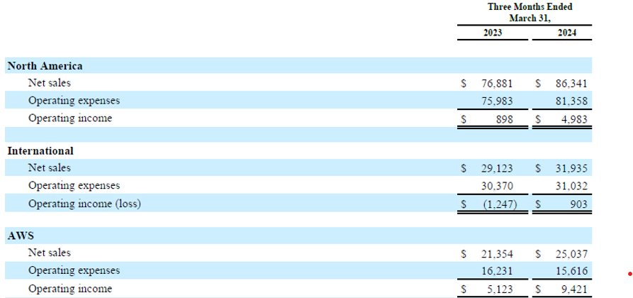
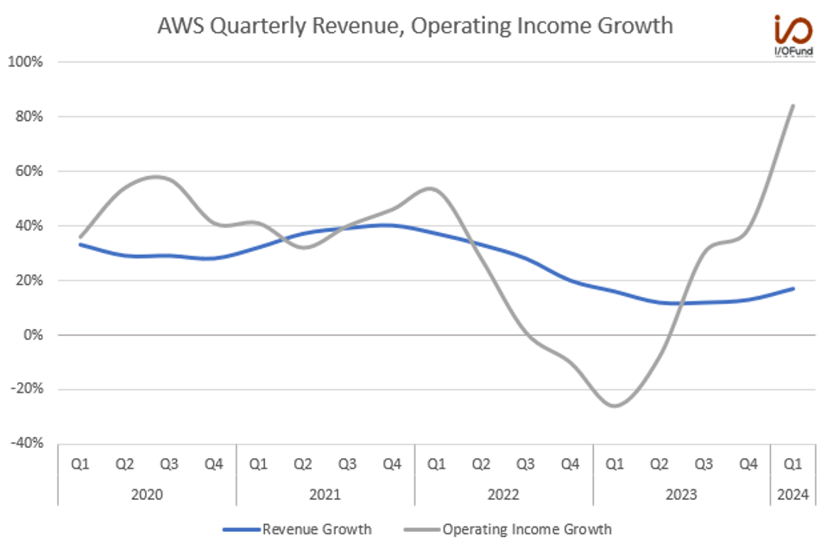
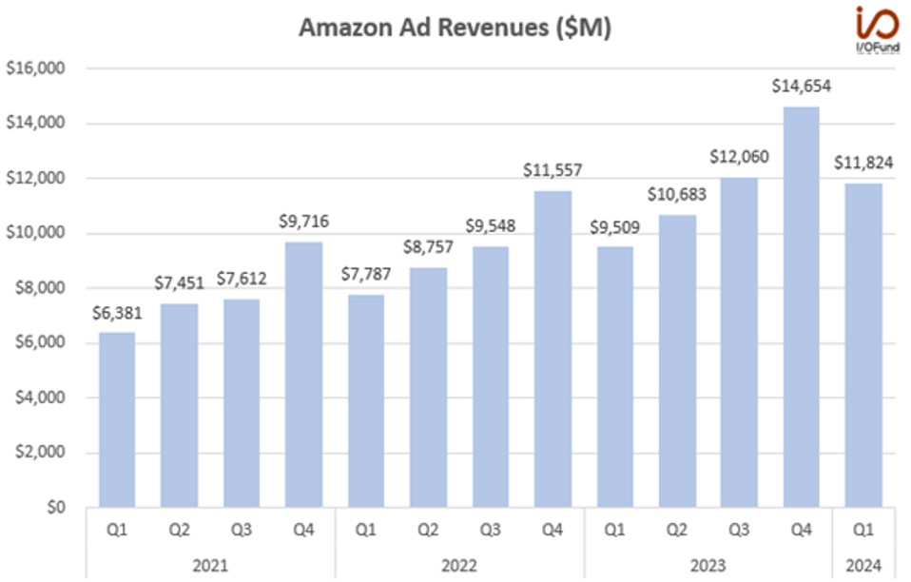
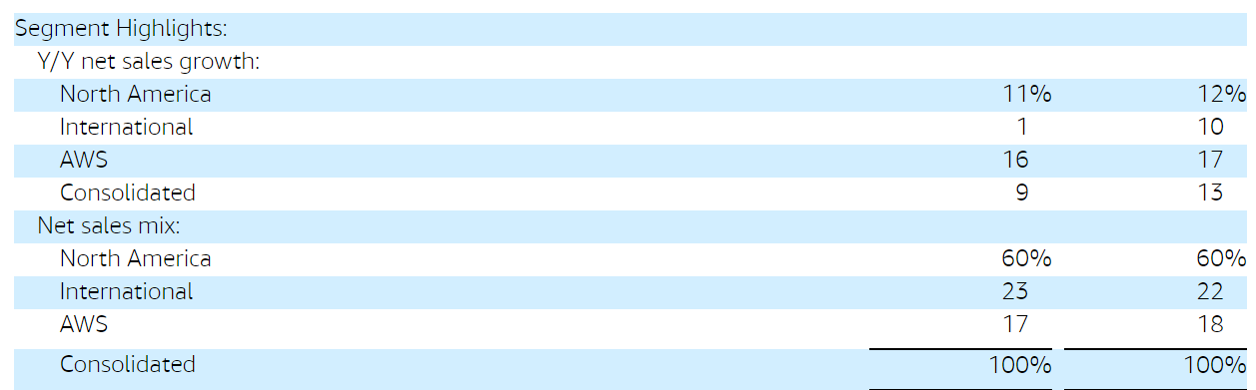
Segmentation
Revenue segmentation (in millions)
FY2024E Revenue Growth Contribution
Advertising is Amazon’s fastest growing segment with 24% YoY growth to $11.8 billion in revenue in 2024.
AWS re-accelerated 4% points to 17% YoY growth in the quarter, while operating income grew 84% YOY.
Notes:
North America segment operating income was $5 billion, an increase of $4.1 billion year-over-year. Operating margin was 5.8%, up 460 basis points year-over-year. We saw improvements in our cost to serve, including continued benefit from our work to regionalize our operations, savings from more consolidated customer shipments, and improved leverage driven by strong unit growth, and lower transportation rates.
In our International segment, operating income was $903 million, an improvement of $2.2 billion year-over-year. Operating margin was 2.8%, up 710 basis points year-over-year. This is primarily driven by our established countries as we improve cost efficiencies through network design enhancements and improved volume leverage.
Moving to AWS. Revenue was $25 billion, an increase of 17% year-over-year, and AWS is now a $100 billion annualized revenue run rate business. Excluding the impact from Leap Year, AWS revenue increased approximately 16% year-over-year

Slide 10
Company Guidance
Second Quarter 2024: PUT THE GROWTH
Net sales
Net sales are expected to be between $144.0 billion and $149.0 billion, or to grow between 7% and 11% compared with second quarter 2023.
This guidance anticipates an unfavorable impact of approximately 60 basis points from foreign exchange rates. In first quarter 2024 the impact from Leap Year added approximately 120 basis points to the year-over-year net sales growth rate.
Operating Income
Operating income is expected to be between $10.0 billion and $14.0 billion,
compared with $7.7 billion in second quarter 2023.
Notes:
This guidance assumes, among other things, that no additional business acquisitions, restructurings, or legal settlements are concluded.

Slide 11
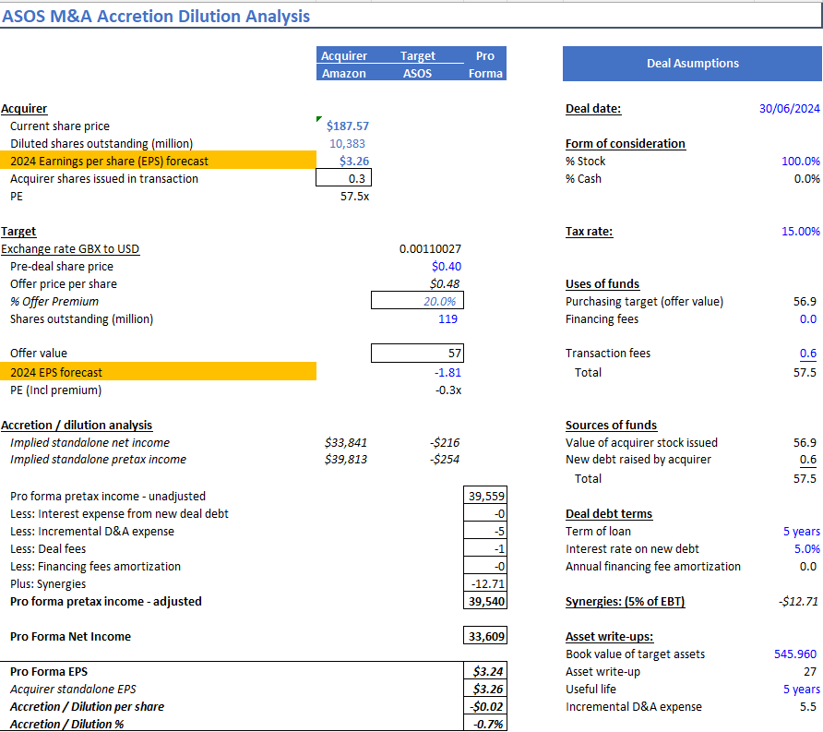
Potential Acquisition Target
Notes:
5% EBIT synergies presumed
0.02% dilution
0% year term bank loan at 5%
100% stock and 20% premium
Offer price of USD ?
There can be situations where EPS and PE might suggest opposite outcomes. This can happen due to factors like:
Acquisition cost: If the purchase price for the target company is very high, it might outweigh the target's earnings contribution, leading to dilutive EPS despite a lower target company PE.
Issuing new shares: Financing the deal with new shares dilutes existing shares, potentially lowering EPS even if the target is profitable.
In such cases, analysts delve deeper:
They consider the long-term strategic benefits of the deal beyond immediate EPS impact.
They project future EPS taking into account synergies, cost savings, and revenue growth potential from the acquisition.
Amazon would gain in UK market
For Accretion:
Asos Profitability: If Asos becomes profitable again (they reported a loss in fiscal year 2023), and Amazon integrates them efficiently, it could boost Amazon's overall EPS.
Synergies: Combining operations, logistics, and potentially product lines could lead to cost savings and revenue growth, increasing EPS for the combined entity.
Amazon's PE Ratio: If the acquisition price values Asos at a lower PE ratio than Amazon's current PE, it could be accretive as Amazon's higher EPS absorbs Asos'.
For Dilution:
Asos's Current Losses: Asos's negative EPS would dilute Amazon's EPS in the short term.
Acquisition Costs: A high purchase price for Asos could outweigh any future profitability gains, leading to dilution.
Issuing New Shares: If Amazon finances the deal with new shares, it would dilute existing shareholders' ownership and potentially EPS.

Slide 12
III. INDUSTRY OVERVIEW

Slide 13
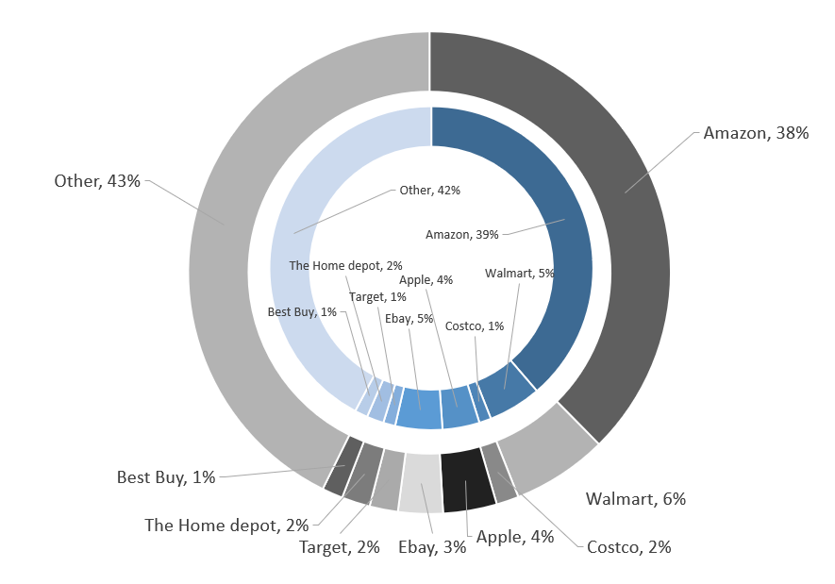
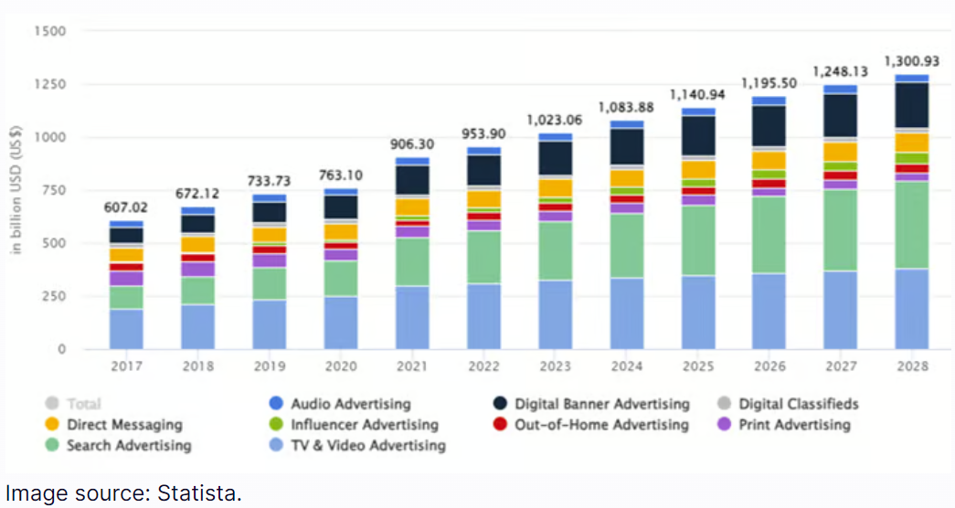
Drivers
Amazon (NASDAQ: AMZN) e-commerce accounts for + than a third of all U.S. e-commerce sales.
E-commerce ~67% of total sales. Online store sales increased 9% YOY, and third-party sales rose 20%.
AWS increased 13% YOY.
Ad sales increased 27% YOY: Amazon's third-largest segment, and fastest growing at $14 billion, 8% of sales.
The advent of AI as a major force in business advertising driving substantial growth.
Amazon has powerful AI capabilities that help advertisers find the right audience with hundreds of millions of shoppers on its website looking for products advertisers offer.
The company recently launched sponsored TV ads in the U.S. to open up the opportunity to smaller businesses that don't have large budgets and expand its own opportunities. Sales increase dramatically for its football streaming with developing full ad capabilities.
Market share 2024 compared to 2020
Advertising Industry growth

Slide 14
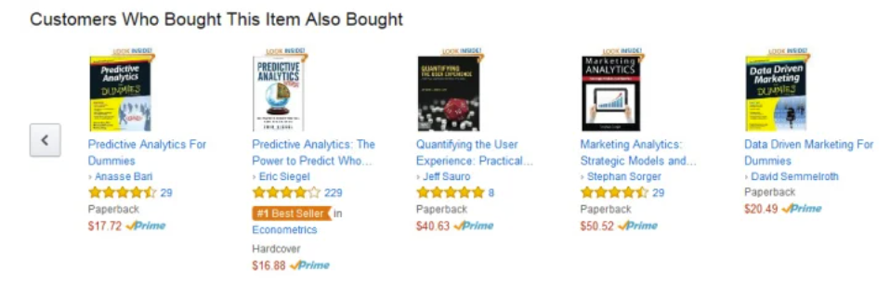
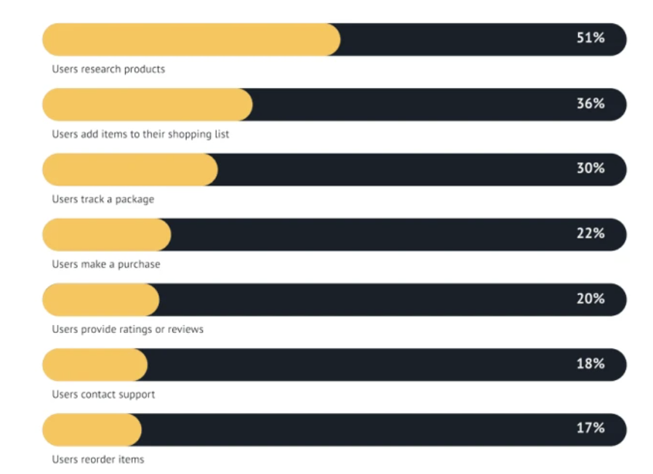
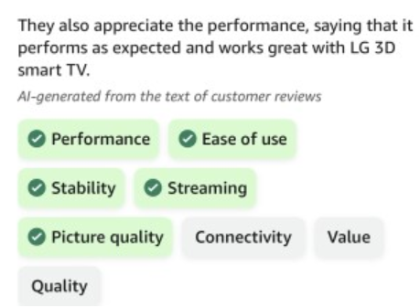
Industry Trends
Integration of AI in product recommendations
Sustainability and eco-friendly practices
Amazon enables customers to easily identify and choose sustainable products. Sellers who align with this trend will benefit from Amazon's initiatives to spotlight sustainable products.
Social commerce
Partnership with Meta
Global expansion and cross-border ecommerce opportunities.
Through Amazon Global Selling: sellers can list products on international marketplaces.
Advancements in advertising strategies:
Amazon's "Sponsored Brands" feature empowers sellers to showcase a collection of products, fostering brand visibility and customer engagement. In the future, sellers can expect enhanced targeting options, better analytics, and a more intuitive ad creation process. Innovations like augmented reality (AR) ads and interactive ad formats could become staples in Amazon's advertising toolbox.
Voice search in ecommerce: Amazon Alexa
Qcommerce (quick commerce): market worldwide expected to grow at 9.77%, resulting in a projected market volume of over $251 billion by 2028.
Expansion driven by the increasing need for speedy delivery, e.g. essential items like household goods.
Customer reviews and reputation management:
Amazon implements generative AI in its platform that summarizes customer product reviews.
Adding Alexa increases:
Notes:
Amazon Followers allows shoppers to opt-in to receive notifications about a specific brand on Amazon.
And on the other hand, it’s working closely with existing social media platforms and their respective shopping capabilities. Amazon recently announced a new partnership with Meta that allows users to shop Amazon’s Facebook and Instagram ads and check out with Amazon without leaving the apps. Amazon has also mastered the art of building social communities around its products, such as #amazonfinds on TikTok, which allows users to share their favorite Amazon product discoveries on the app. By leaning on influencers and users to create engaging content, such as authentic reviews and demonstrations, Amazon can boost product visibility organically.

Slide 15
IV. VALUATION

Slide 16
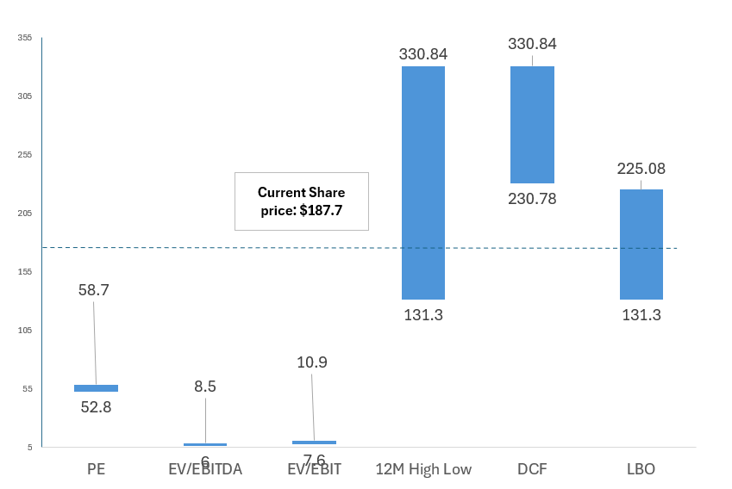
Share price valuation Range

Slide 17
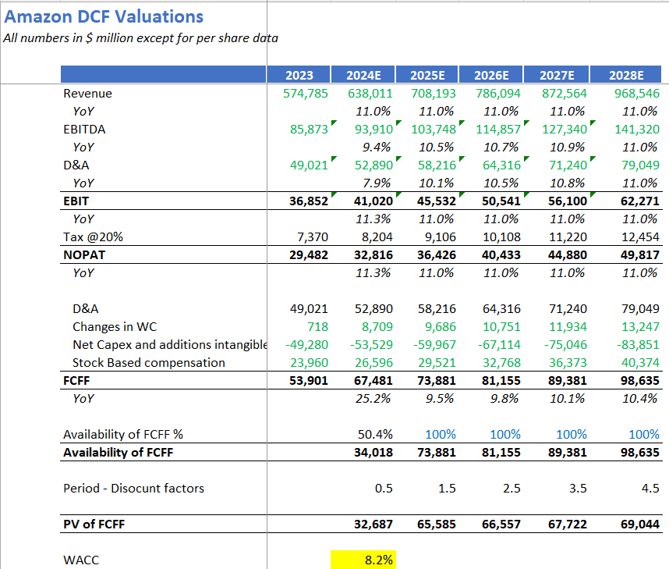
DCF – (Base case)

Slide 18
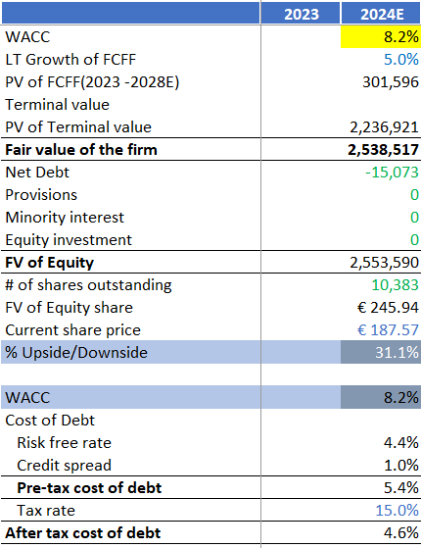
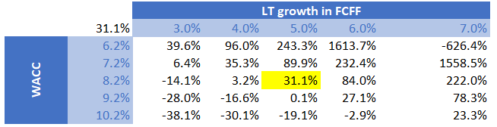
DCF – Cont.
Base Case: $307.75 (64.1% Upside)
Revenue estimates based on segment analysis with 11% growth
8.2% WACC and long term FCF growth of 5%
Bull Case: $573.51 (205.8% Upside)
Revenue estimates at 20% growth.
8.2% WACC and FCF growth rate of 5%
Bear Case: $236.41 (26% Upside)
Min revenue growth estimate at 7% as the year before revenue growth rate due to extra costs.
8.2% WACC and 5% long term FCF growth rate still lower than expected average of 8% in the industry.

Slide 19
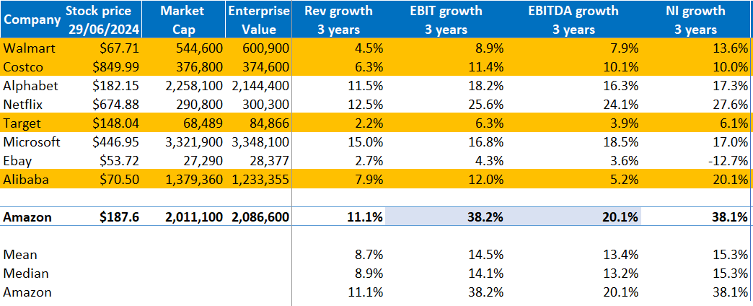
Public comparable
Among large-cap peers, Amazon seems trading at fair value given its 20-for-1 stock split in 2022 and higher expected revenue growth than its peers in the e-commerce and tech industry.
Costco seems overvalued given its revenue growth lower than the mean.
Alibaba trades at a lower price but with a significant market cap due to a large number of shares issued.
Amazon growth rate, market cap and stock price is comparable with the large cap tech companies Alphabet and Microsoft primarily due to its significant revenue derived from its AWS segment, cloud and data storage services.

Slide 20
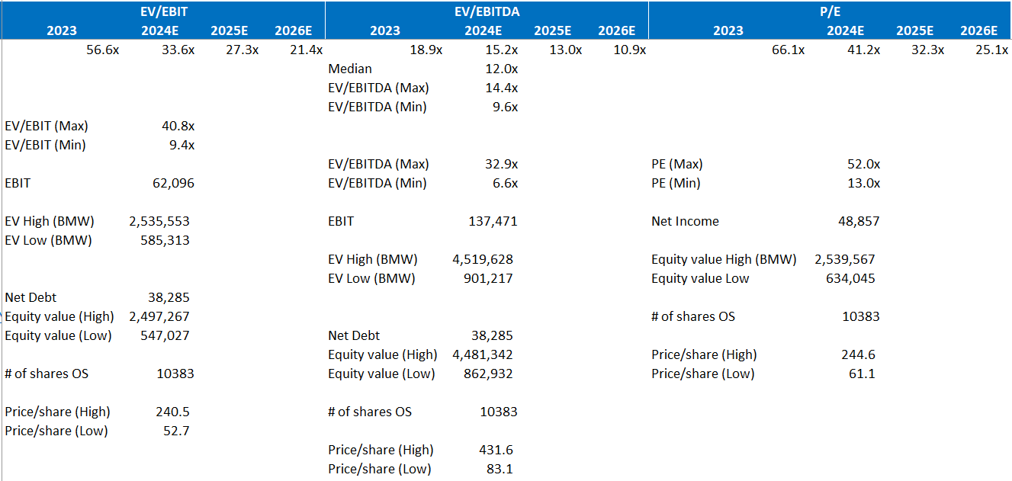
Amazon compared to Walmart, Costco, Target, Alibaba

Slide 21
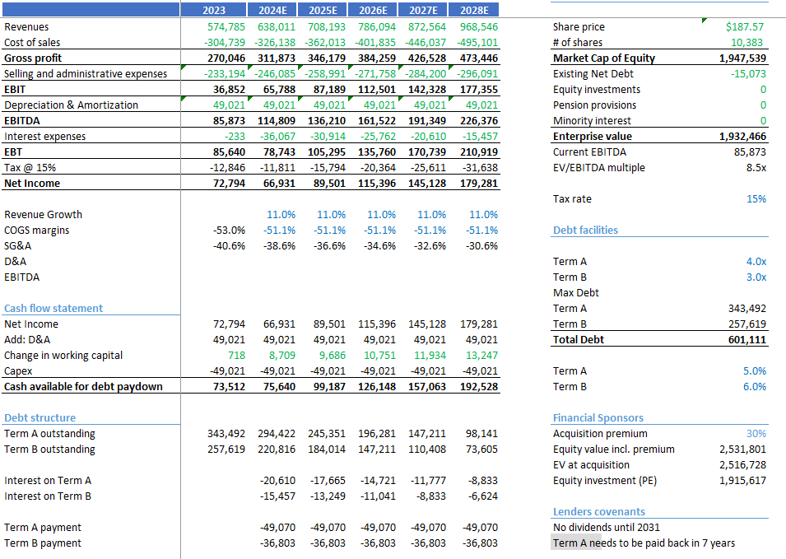
LBO

Slide 22
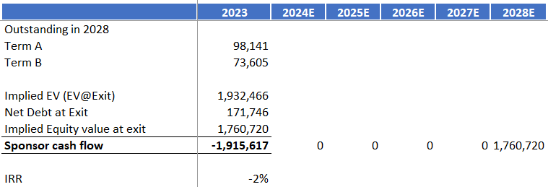
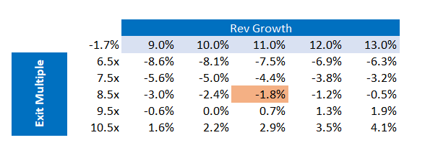
LBO – Cont.
Base Case: $187.57 (Current Price)
No premium
Entry Multiple the same as Exit Multiple
(-1.7)% IRR
0.92x CoC
Bull Case: $225.08
20% premium
Entry Multiple the same as Exit Multiple
(-2.4)% IRR
2.3x CoC
Bear Case: $131.30
30% discount
Entry Multiple the same as Exit Multiple
0.4% IRR
1.01x CoC

Slide 23
Recommendation
Recommendation: Buy Current price: $187.57 Price Target: $245.94
31.1% Upside
E-commerce developments and delivery efficiency will continue driving demand for Amazon products from consumers and sellers.
Opening to the fashion industry will increase the range of products and reduce reliance on fashion brands. ASOS will enable an opening on the UK market.
Strong growth of AI will continue increasing demand for Amazon AWS services.
Ultimately I believe the market price is representative of Amazon expected future growth, leaving space to value increase fairly as the tech industry will develop exponentially in the near future driving Amazon share price high.

